Slide 1

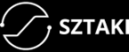
Pintye István
Laboratory of Parallel and Distributed Systems
SZTAKI Institute for Computer Science and Control

Slide 2

An evolutionary approach for neural network based agents applied on time series data in the Cloud
Subtitle
Applied Machine Learning in Stock Market
Notes:
I am going to talk about distributed evolutionary selection, and what we tried to find with this method is the weights of a given neural network.
So it is a distributed neuro evolution – which is quite an old technic, but we did a couple of interesting things and I try to show that this can still be a useful approach in some cases.

Slide 3
Overview of the presentation
1. Let me introduce the historical Forex timeseries (EUR/USD) and its statistics.
2. How did I define the problem/task?
3. What does the algorithm look like?
4. The architecture of the computation resources.
5. What is the advantage of this solution?
6. The relation between the algorithm and the computation architecture.
Notes:
To demonstrate the usability of this approach we chose a time series which comes from the forex market – this dataset is the Euro USD exchange rate from 2 tausend till now in a minute resolution – which means that we had 5.6 million observations.

Slide 4
About the EUR/USD exchange rate
It is important to note the following things:
Historical time series, ordered data
The future is unknown
The future is also unpredictable
We can not affect it (unless we are politicians or policymakers or members of the Federal Reserve System)
It is hard even if not impossible to execute experiments or create controlled tests and hypotheses because the circumstances are always changing.
On the whole, it is a very complex and interesting system.
Notes:
It is ordered data. The future of the exchange rate is unknow, and unpredictible. We can not control the price. In other words, we are too small players in a huge market. It is hard even if not impossible to execute experiments or create controlled tests and hypotheses because the circumstances are always changing.

Slide 5
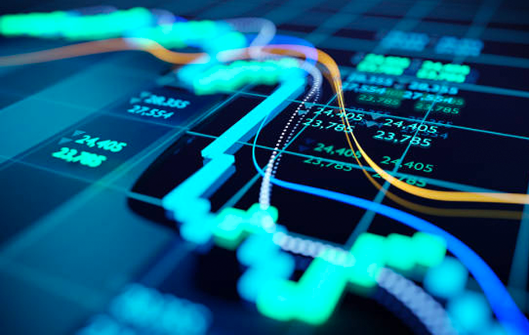

What would we like to explore?
What if we try to follow the movement of the price? (To keep this topic, and explanation simple, it means that I wanted to write an algorithm that is able to find a strategy (which is profitable), with the help of a Machine Learning algorithm.
Notes:
So what was our question? Can we follow the movement of the price? Can we take advantage of this? And if the answer is yes then how does look a system like this?
I also like to mention that this article that I am going to show you today is the first part of a series of articles. We wrote and explained in this article the main concept of our system and shared some results.

Slide 6
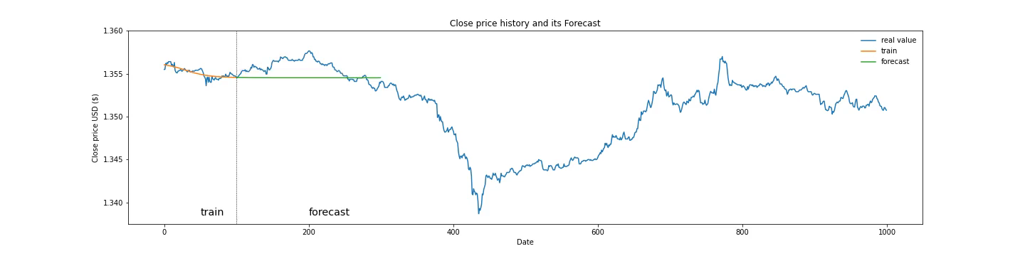
Motivation and Propositions
Instead of trying to predict the future of a given time series at any given point in time – like the animation shows – we chose another approach.
Notes:
Instead of trying to predict the future of a given time series at any given point in time – like the animation shows – we chose another approach.

Slide 7

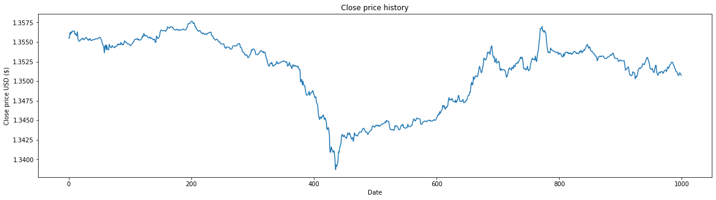
Motivation and Propositions
We also could have defined this as a classification problem, if we annotate the data where or when should we buy where should we sell, then we have to train the algorithm to find some relation between the labeled data and the input, where the input is the past of the time series itself.
Sell
Sell
Sell
Sell
Sell
Sell
Buy
Buy
Buy
Buy
Buy
Buy
Notes:
We also could have defined this as a classification problem, if we annotate the data where or when should we buy and where should we sell, then we have to train the algorithm to find some relation between the labeled data and the input, where the input is the past of the time series itself.
But there are a lot of problems with this approach. We drop a lot of useful information if we do not use all of the data. Or each point should belong to one of the three categories (buy, neutral, sell) It doesn’t matter how we want to label the data it always will be problematic.

Slide 8
Our approach
Instead of annotating the low entry point of trades and high exit points of trade manually, we wanted to find these points automatically and algorithmically.
So our objective function was to maximize the distance between the buy prices and sell prices, based on the price history itself.
Sell
Sell
Profit or Gain
Buy
Notes:
I would like to give you an example.
For example in this case, this solution would have a very good results.
The green area depict the profit of the given trade.
This is what we would like to maximize.
In this case this wouldn’t be any better. (or …)

Slide 9
Our approach
Instead of annotating the low entry point of trades and high exit points of trade manually, we wanted to find these points automatically and algorithmically.
So our objective function was to maximize the distance between the buy prices and sell prices, based on the price history itself.
Sell
Sell
Buy
Notes:
But I have to highlight the fact that his is also a good solution even if is not so good as the previous one.

Slide 10
Our approach
Instead of annotating the low entry point of trades and high exit points of trade manually, we wanted to find these points automatically and algorithmically.
So our objective function was to maximize the distance between the buy prices and sell prices, based on the price history itself.
Sell
Sell
Sell
Sell
Buy
Buy
Buy
Notes:
In fact - many other – and even better solutions exist – and this is what we are trying to find programmatically.

Slide 11
How did we define the task?
We wanted to learn something from the historical data – the past of the given timeseries.
We needed a function that creates these entry and exit points.
This function will be a Neural Net
What we wanted to maximize is the sum of the returns of the trades
What we were looking for is the weights of the Neural Network.
Notes:
Itt az a szöveg ami a képernyőn van.

Slide 12
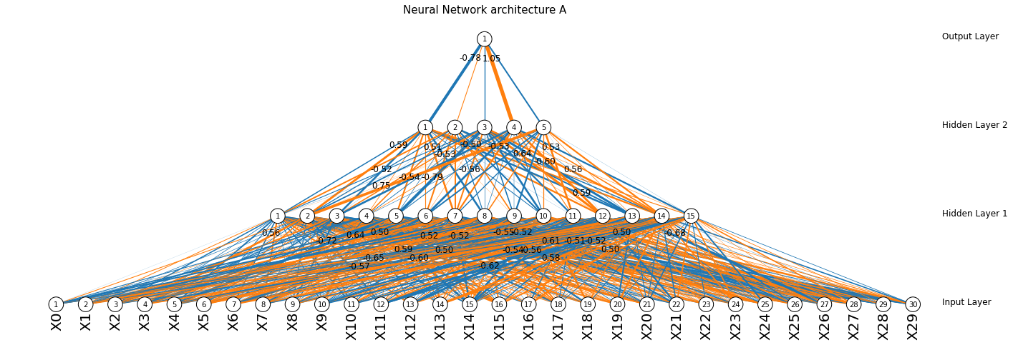
How does this relate to the architect?
Lags of the timeseries at any given point in time from (t-1, to t-30)
Notes:
I cite this picture only to get a better insight how does the neural network look like.
The thickness of the lines represents the weight of the connection, the thicker the bigger, while the color of the lines is the sign of the weight (blue is negative).
What we are trying to find is the best weight of the Neural Net.
The bottom lines (blobs) are the input of the neural network. In this case, the lookback window was 30 (thirty) so we have 30 inputs, but this number can chose a bigger lookback window. Of course, if we have more inputs or we choose a longer lookback window then the neural network will be more complex.
While we do not know what are the best weights, we try out a lot of possible candidates and choose the best one from time to time.

Slide 13
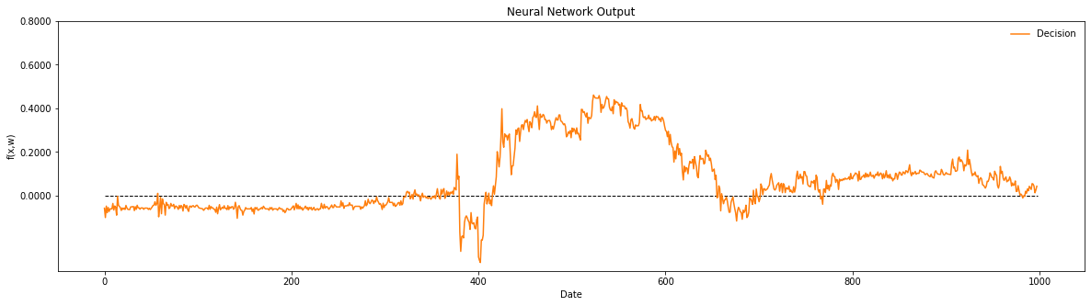
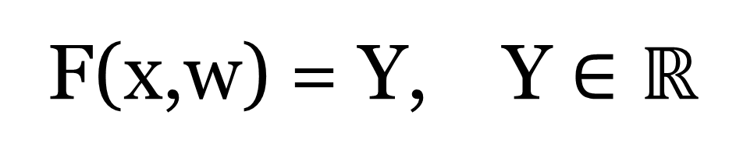
F(x,w) = Y, Y $∈ℝ$
Notes:
So I send the candidate neural net to the worker – which does push this neural network through the given time series – just like a convolution (or a function)
The input of the Neural Net is the last 30 values of the price at any given time.
The output of the Neural net is a Real Number.
It is important to understand that I do not want to estimate or approximate the original time series with the neural network at all.!
Instead of this, I wanted to create a function that „finds the inflection points of the original time series” if you will. And this whole thing comes from the past of the time series itself.

Slide 14
F(x,w) = Y, Y $∈ℝ$
When Y >0 then Buy
When Y <0 then Sell
Profit of the given trade
Notes:
When this number is bigger than 0 then we open a buy position and when it is less than 0 then we Close the opened Buy Position and sell the given instrument.
If the output of the Neural Net is greater than 0 then buy at the given price (let this mean buy)
If the output of the NN is less than 0 then sell at given price.

Slide 15
F(x,w) = Y, Y $∈ℝ$
When Y >0 then Buy
When Y <0 then Sell
Loss also can occure
Notes:
If the sell price is less than the buy price then we call it a loss of the given trade, as I highlighted with the apricot in this picture.

Slide 16
F(x,w) = Y, Y $∈ℝ$
When Y >0 then Buy
When Y <0 then Sell
Notes:
Of course, there are a lot of other trades in this picture, because the setup trading rules are mutually exclusive.

Slide 17
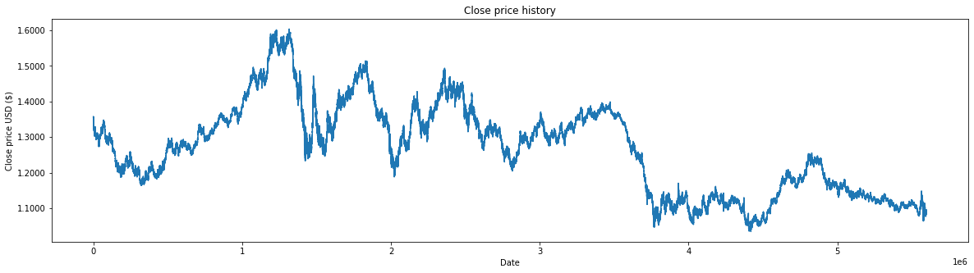
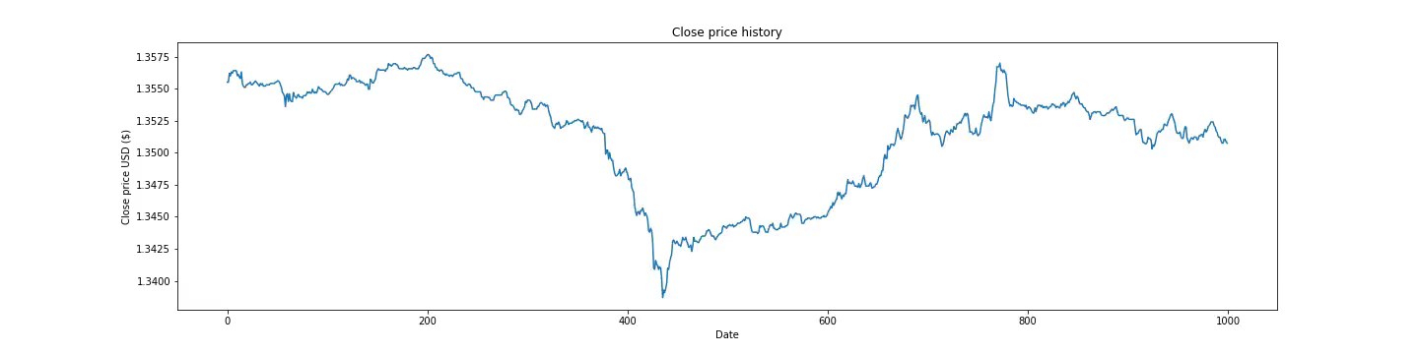
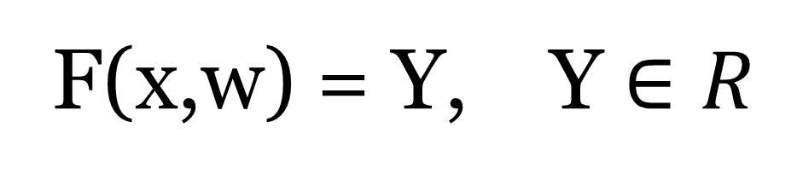
F(x,w) = Y, Y $∈R$
When Y >0 then Buy
When Y <0 then Sell
As you can see there is 1000 observation on the plot.
But the truth is that we have 5.6 million observations.
Notes:
As you can see we have 1000 observations, but the truth is that we have 5.6 million observations.
Just to give you a better insight, here is one pixel wide is what I showed you earlier.
And what you see on the bottem is still a fifth of the entire dataset.
The bottom plot shows only a fifth of the observations.
The whole dataset is shown on the top plot. So I hope that you have got the point.

Slide 18
How did we find the proper weights of NN?
With Evolutionary Selection.
What was our motivation?
We wanted to decrease the computation time, We wanted to get the results faster.
Cloud resources are cheap and easy to access.
This task is embarecing parralel. (candidate solution can be tested/computed parallel.)
Otherwise, when we tried to do this sequentially it took an incredibly long time.
Notes:
We search the weight of the neural net with evolutionary search
And our motivation was to decrease the computation time.

Slide 19
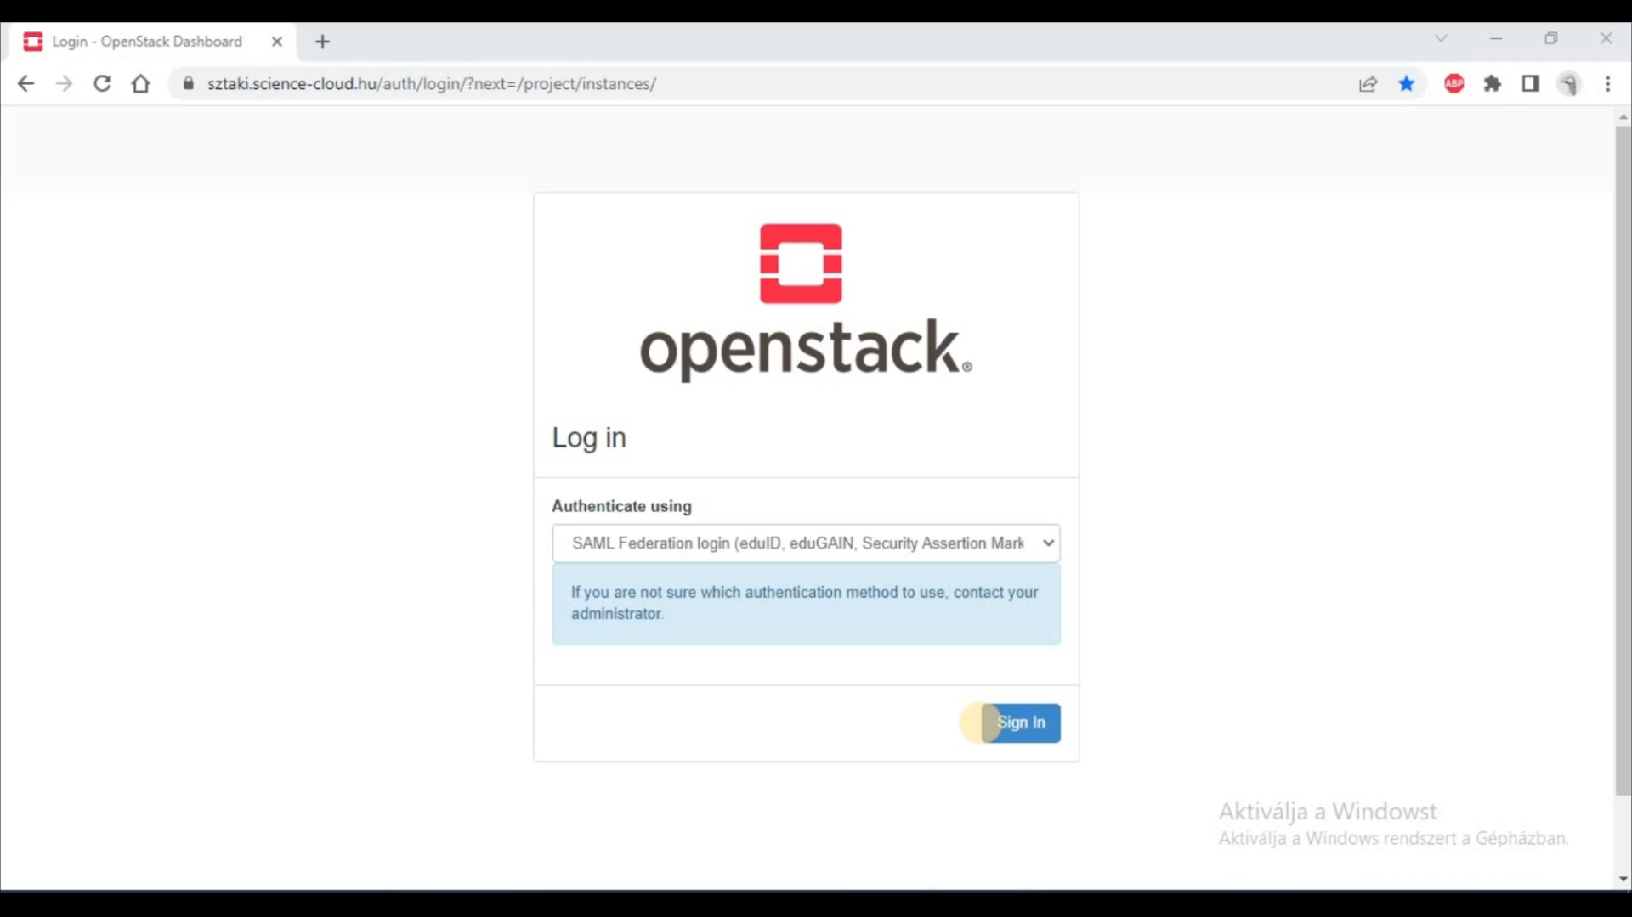
Notes:
But before going further let me show you a short screencast about cloud deployment because most people can think this is some complicated thing but it isn’t.
In our case, this whole deployment process is driven by a Python script that creates and initializes the proper amount of Virtual Machines in the Cloud and distributes the data (which has to be done once)
But I just wanted you to get a better idea of what happens behind the scene.
When the video finished:
If we want to take maximum advantage of parallelism then we should create as many instances as the population size in our Evolutionary Selection.
Of course, we also can take advantage of parallelism if these two number is not equal.
Why did I do this? Because I want to run something in parallel on different machines and shortly I am going to tell you why,

Slide 20

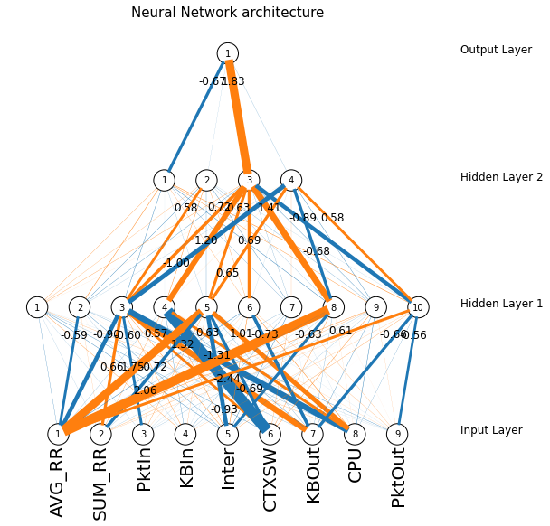

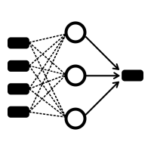
How did we implement this?
We take the cloud
We also have a Driver
Let’s call them Workers
Notes:
So we take the cloud
Create a lot of Virtual Machines (as many as the population size)
We also have a Driver, who initializes this whole cluster (so we do not take care of this)
It creates a Neural Network with a given architecture.
Not just one but many, and of course with different weights. (Well of course these are just random guests)

Slide 21
How does this relate to the architect?
We take the cloud
We also have a Driver
Let’s call them Workers
Notes:
The driver takes care of the selection, the crossover, and the mutation (these are the less computation-intensive tasks)
And the workers do the computation-intensive part of the task (which if I have a huge amount of data it can take a while)

Slide 22

How does this relate to the architect?
We take the cloud
We also have a Driver
0.793472
-0.192851
0.509245
0.691328
Fitness scores
0.650215
0.112497
0.242150
0.115641
. .
Let’s call them Workers
Notes:
What do the workers do? They compute the output of the f(x,w) function for every observation and compute the fitness score of the given solution – which is in this case the total gain of the trades. (let’s say the profit)
It takes a while for every worker to get the results. For example get the result of every F(x,w) and based on that value calculate the fitness score of the given solution.
But immediately after a Worker finished their job, it sends back the fitness score to the driver, which holds the given solution in its memory.
Sorts the solution by the fitness score.
We apply some sort of selection mechanism. (For example, select the best or the best two)
Apply some crossover on this (or not)
Mutate the new candidates a little bit
Distribute the new candidates again among the workers
Until it reaches some predefined stop criteria.

Slide 23
How does this relate to the architect?
We take the cloud
We also have a Driver
Repeat this process until it reaches some predefined value (while hopefully we find better and better solutions)
. .
Let’s call them Workers
Notes:
Repeat this process until it reaches some predefined value (while hopefully we find better and better solutions)

Slide 24
Results
First of all, I have to tell you the above-described method or approach is one possible solution to the task and not superior but works (which means)
We were able to find a better solution than the random guest in the test sample. We were able to verify this on the test sample as well.
We applied two types of verification.
1. First, we split the data train test sample in an 80:20 ratio.
2. We split the data into three-part (train, test, hold out)
Notes:
Of course overfitting can occur so we tested this method in two ways.
First we split the data into a train and test sample.
Second we split the data into a train, a test, and a holdout sample, and we continued the evolutionary search as the new data was coming in. (arrived)

Slide 25
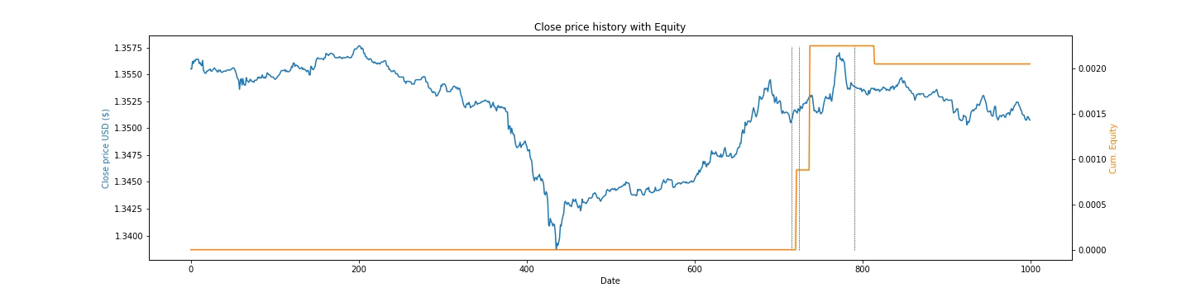
How does the equity change through evolution?
First of all, I have to tell you the above-described method or approach is one possible solution to the task and not superior but works (which means)
We were able to find a better solution than the random guest in the test sample. We were able to verify this on the test sample as well
EURUSD Price
Equity
Notes:
Let me show you an animation. The orange line is the equity (or the gain of the trades). This is what we want to maximize. While the blue line is the given price of the given instrument.
This short animation shows us how to change the Equity (orange line) through evolution.
The plot shows only a short slice of the whole time series (by the way)
But you can see that the algorithm could find a very good solution.

Slide 26
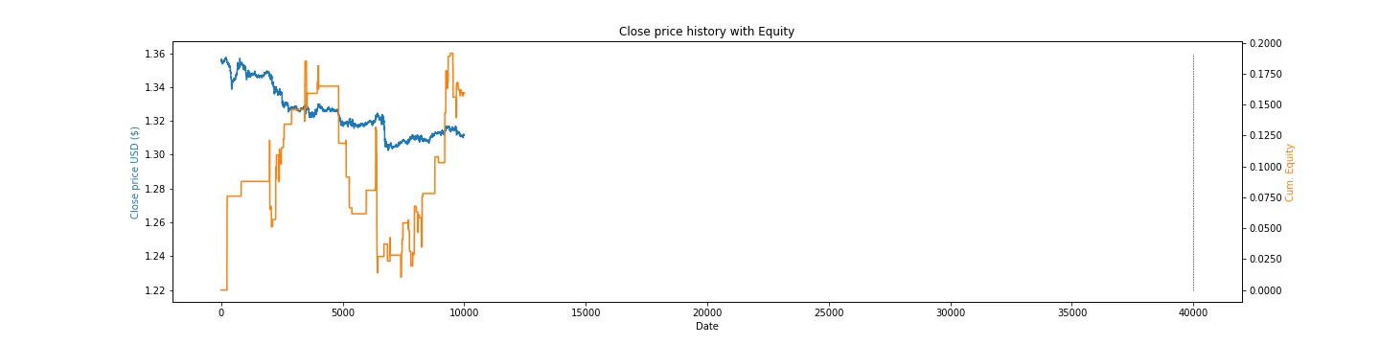
Results 3/1.
We run a lot of experiments with different setups. And we could do this mainly because the search run an order of magnitude faster on the cloud in this case.
We were able to find a better solution than the random guest in the test sample.
We were able to verify this on the test sample as well.
Notes:
Let me show you an animation. The orange line is the equity (or the gain of the trades). This is what we want to maximize. While the blue line is the given price of the given instrument. Now the interesting thing is that the learned relationship between the past and the trading action remains profitable on the unseen test sample, without any modification of the neural network. (The vertical line shows the end of the training sample)
We did a lot of tests. Examine the distribution of the trades, compared the train and the test distribution.
We want to show that this sort of Neuro evolution can work on financial dataset like EURUSD even if the technology is old and outdated.
We were able to make the computation faster using cloud infrastructures. (which is extremely important if we have a huge amount of data)

Slide 27
Results 3/2
(as we increase the population size which is equal to the number of Virtual Machines decreases the computation time.
For example, if we set the population size to 40 then the speed up was around 38 times faster (but this value strongly depends on the size of the data)
but the speed up does not mean that the bigger population size leads to a better solution (better fitness score)
Notes:
Let me show you a picture.

Slide 28
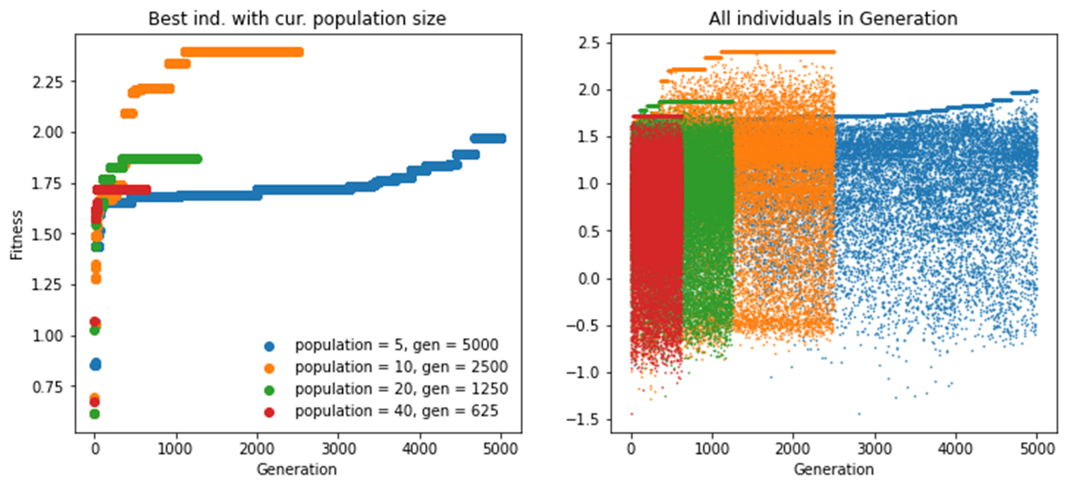
Results
Well, I have to admit that I am not an expert on Evolution Selection, but this result made me a little bit nervous about my program code until I hadn’t understood the reason of this phenomenon.
Notes:
Probably you can not see, but I wanted to know how sensible or stable are some solutions for the variation of the weights.
So this second picture seems to be a little fuzzy but you can imagine the distribution of the fitness scores.
For example, if we watch the orange or the blue dots then we can see that the candidate solution fluctuates around some values.
This horizontal platos developed because we always keep the best solution of the previous generation in the new generation as well.

Slide 29
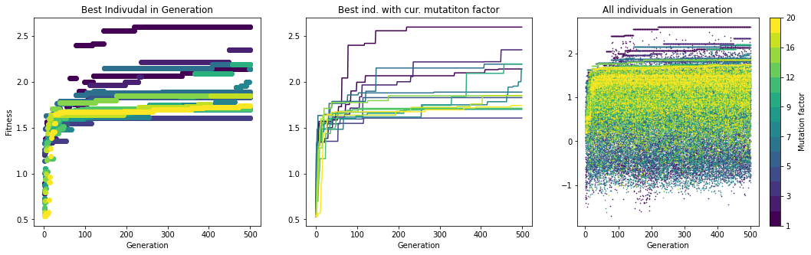
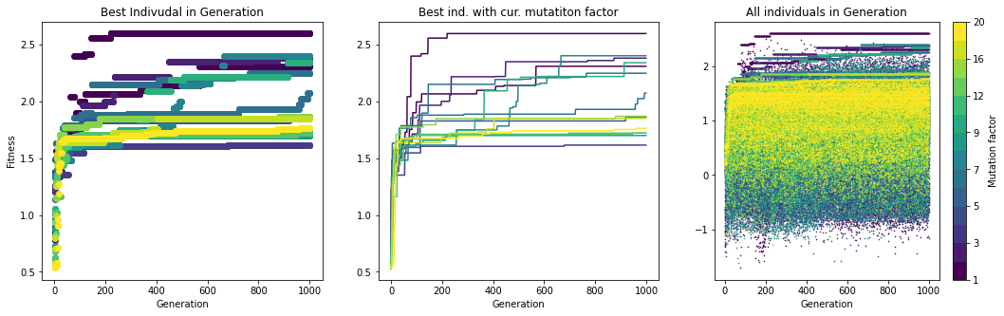
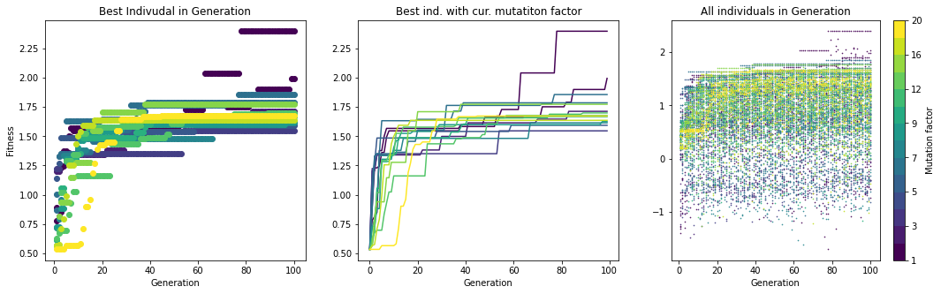
Results
But why was so important for us to increase the processing speed of the computation via parallelizing this searching method. Because it is a metaheuristic and we had a couple of hyperparameters that influence the result.
Notes:
But why was so important for us to increase the processing speed of the computation via parallelizing this searching method.
Because it is a metaheuristic and we had a couple of hyperparameters that influence the result.
I can mention the architecture of the neural net, (for example the number of neurons) or the rate of the mutation of the weight.
So we were able to try a lot of setups to find a better solution.
And we also were able to run a longer experiment.

Slide 30
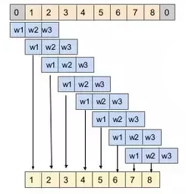
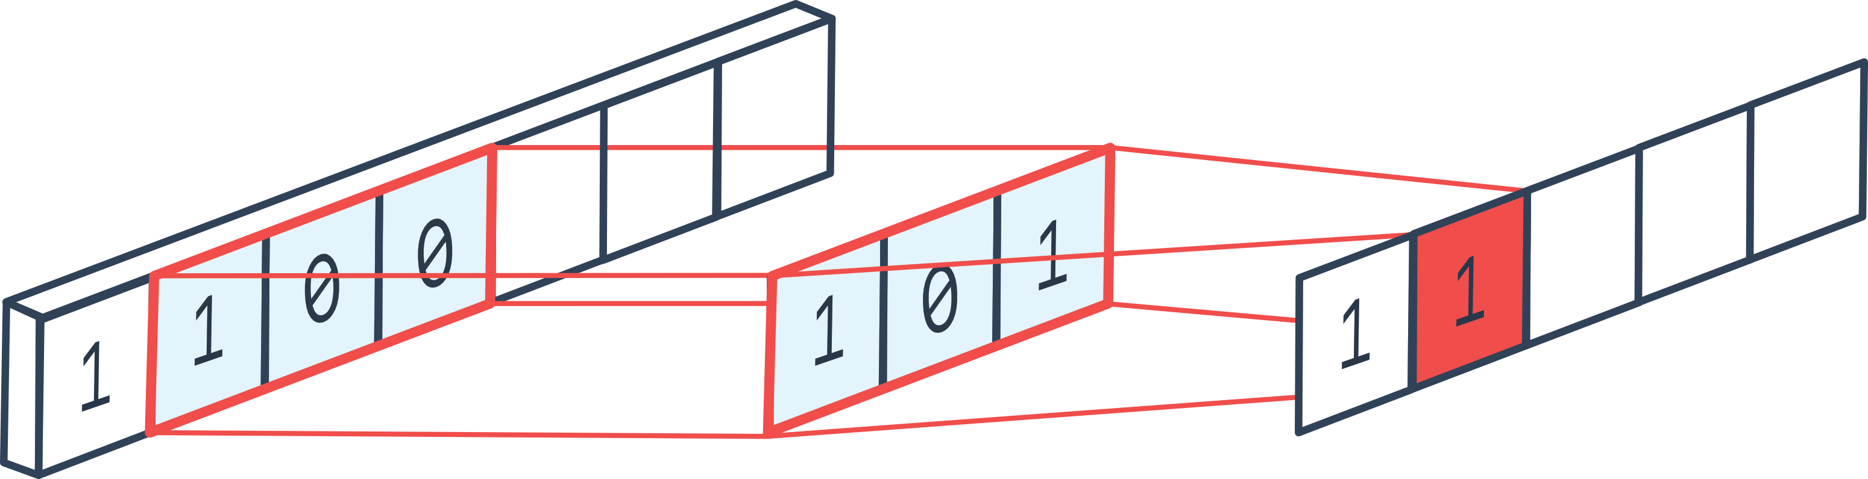
Future works, plans
I’d like to replace the Fully Connected Multi-Layer Perceptron with a Multy Layer Convolutional Network (probably I can reach an even better result with this) (while the way of searching the weight of the net remains the same)
Creates features not only from the given historical time series but from the derived indicators (which are widely used among traders and brokers) – in other words, move from univariate time series to multivariate. Those variables constitute the input of the neural network.
Or take into account not just the time series itself but its moving average, distance from moving average, running standard deviation, etc.
Notes:
I’d like to replace the Fully Connected Multi-Layer Perceptron with a Multy Layer Convolutional Network (probably I can reach an even better result with this) (while the way of searching the weight of the net remains the same)

Slide 31
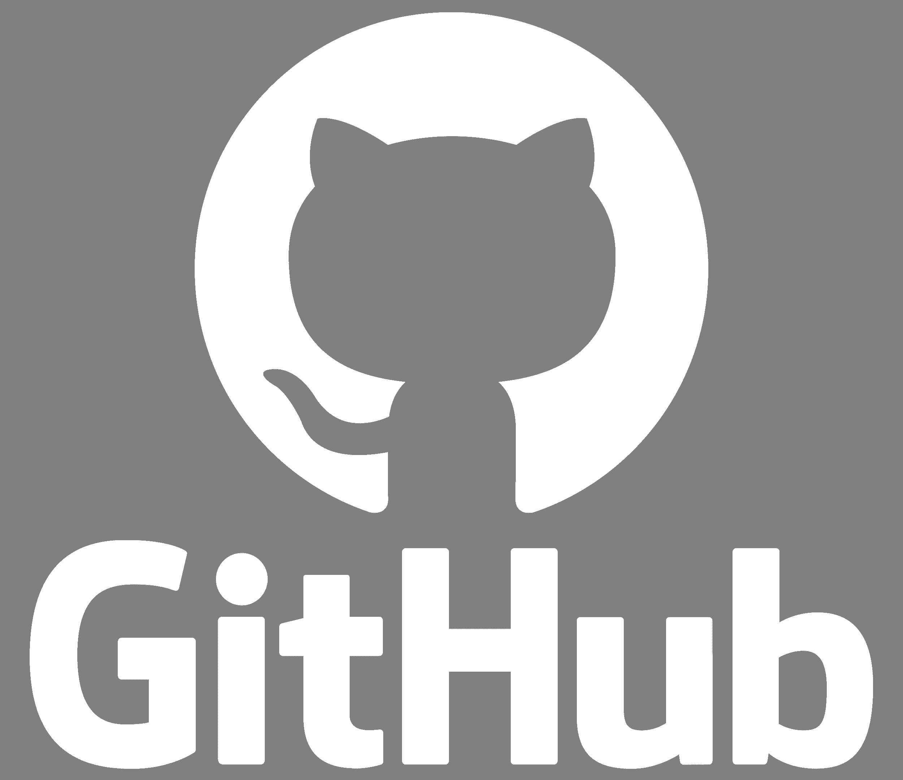
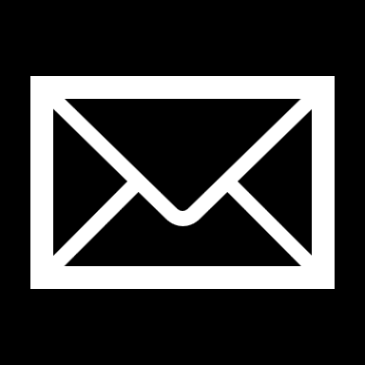
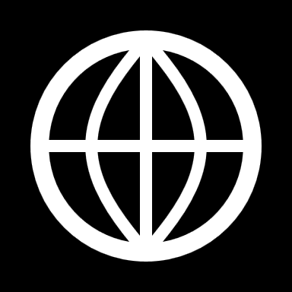
Thank you for your attention
istvan.pintye@sztaki.hu
www.sztaki.hu
Notes:
Thank you for your attention.
The project has a Github repository.
If you are interested in this please feel free to contact me.
We want to show that this sort of Neuro evolution can work on financial dataset like EURUSD even if the technology is old and outdated.
We were able to make the computation faster using cloud infrastructures. (which is extremely important if we have a huge amount of data)

